Slide 1
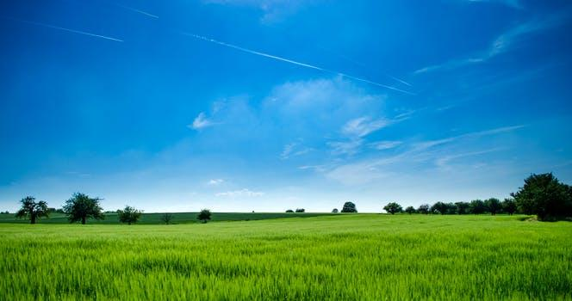
How we can make agriculture a profit venture business ?

Slide 2

Presented by :
Tanmay Gangurde ( FE - Computer )
Tejas Warungase ( FE- Mechanical)
Almas Hatturkar ( FE - E & Tc )
Sakshi Gugale ( FE - Mechanical )
Sejal Ahuja ( FE - Chemical )

Slide 3


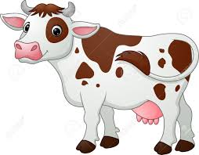
Organic Farming
Jeevamrut - mixture of Gomutra and cow dung cake
Gives birth to Earthworms which helps in improves soil fertility
Use of naturally made pesticide
Transition Period of 3-10 years

Slide 4
Farm structure
Rectangular structure of farming land converted into different strip section.
various crops plantation in each section.
Drip irrigation is used for water supply.
Pumping method is developed around farm land for excess water problem due to heavy rainfall .

Slide 5

Control unit and it’s working
Microcontroller
Condition
More moisture detected Less moisture detected
by sensor by sensor.
Less water supply through drip More water supply through
irrigation and drip irrigation also water
extra water will be automatically will be supplied through
collected into pit through pipes to all field from pit
pumping method. with the help of electric
motor.
NO
YES

Slide 6
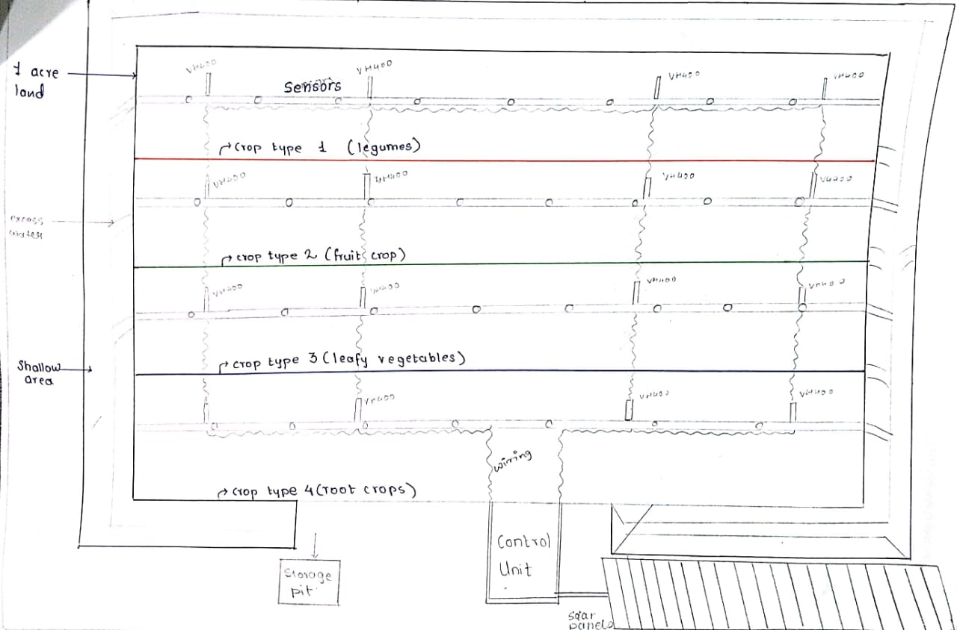
Project Structure

Slide 7
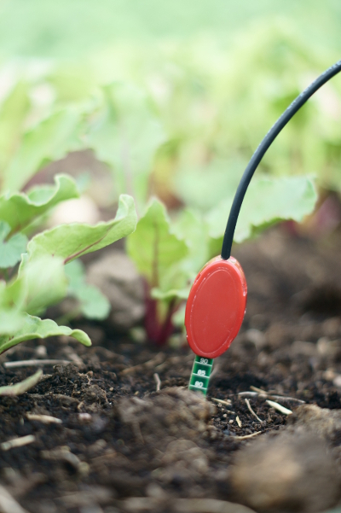
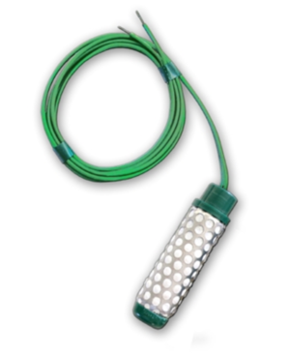
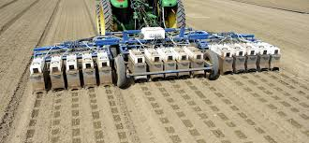
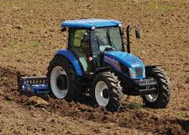
Tools used in Project
Software used for controlling the project : Embedded C
Solar panels for electricity supply to control unit
Tools used in Farming:
Monitoring tractors /Lettuce bot used with telematics , water supplying pipes , Electric motor , soil moisture/ Temperature detecting sensors,

Slide 8
Benefits of Project
Enhancement of Soil Fertility
Controlling the growth of unwanted Pests
At a time, there will be simultaneous production of at least 3 types of crops
Profitable for farmers
Variety of crops at a time

Slide 9
Minimum Requirement for the Project
1 Acre Farming land
Water Supplying Pipes : 4 Pipe lines of 80 meter each
Thermistor sensors : 20 to 25
Manure for 1 Acre : 100 kg per Acre
Seeds : 2 Kg per Acre
Electric Motor : 2

Slide 10
Material and Costing
Mixture of cow dung,cow urine and domestic waste used as fertilizers.
Water Supplying Pipes :
Material Used : Iron GI Conduit (Rs. 55 / meter )
For 4 pipes of 80 meter ( Rs.19,800)
Electric Motor ( Rs. 8,000 with 10 hp )
Wiring ( Rs. 10,000)
Seeds (Cost Depends on the crop)
Thermistor Sensor: (VH400 - 20 to 25 sensors with total cost of Rs. 40,000)
Notes:
Approx 80000/- for total setup

Slide 11


